Slide 1
Clustering
CS3300 Data Science

Slide 2
Unsupervised Learning
Unsupervised learning is when we have no outcome variable or labels, only a feature matrix
Broadly divided into two types:
Dimensionality Reduction
Clustering
Great for exploratory data analysis of high-dimensional data

Slide 3
What is clustering?
In the clustering problem, we attempt to group data points by similarity
State in another way: given a set of data points, we are trying to infer the classes
Applications include:
Identifying similar documents (e.g., search results)
Image analysis and compression
Consumer market segmentation
Exploratory data analysis

Slide 4
Points
Before Clustering
After Clustering

Slide 5
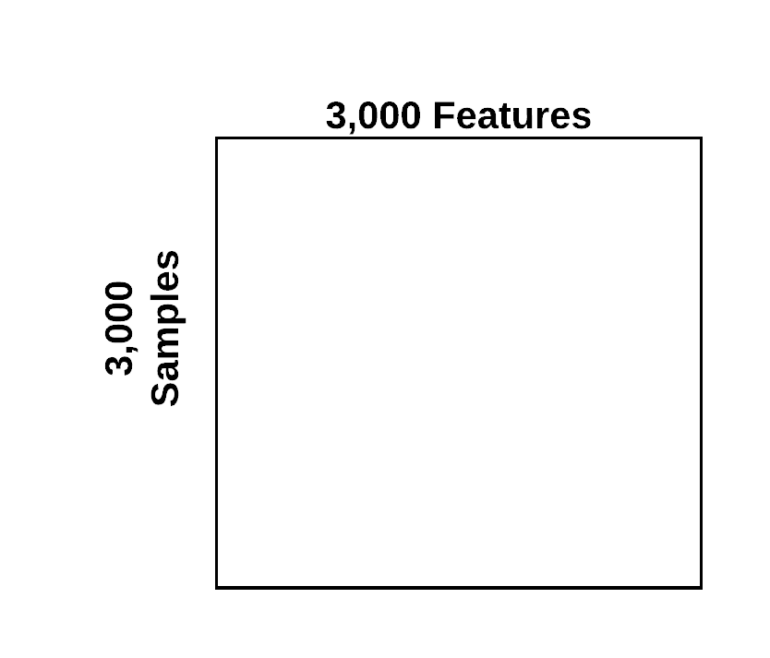
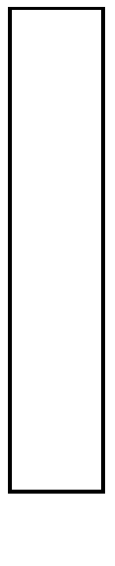
Clustering: Inferring Class Labels
Inferred
Label
Vector
Feature Matrix
Clustering Algorithm

Slide 6
Clusters U.S. Zip Codes by GPS Coordinates

Slide 7
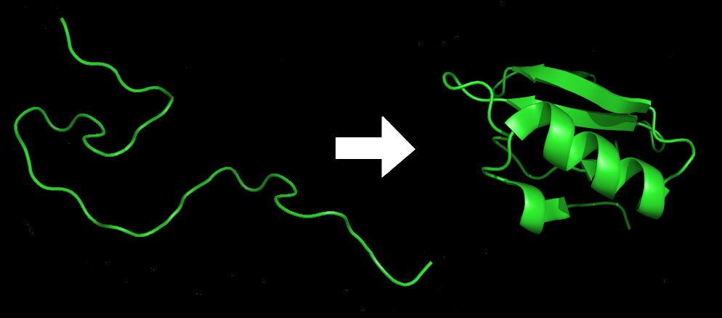
Protein Folding

Slide 8
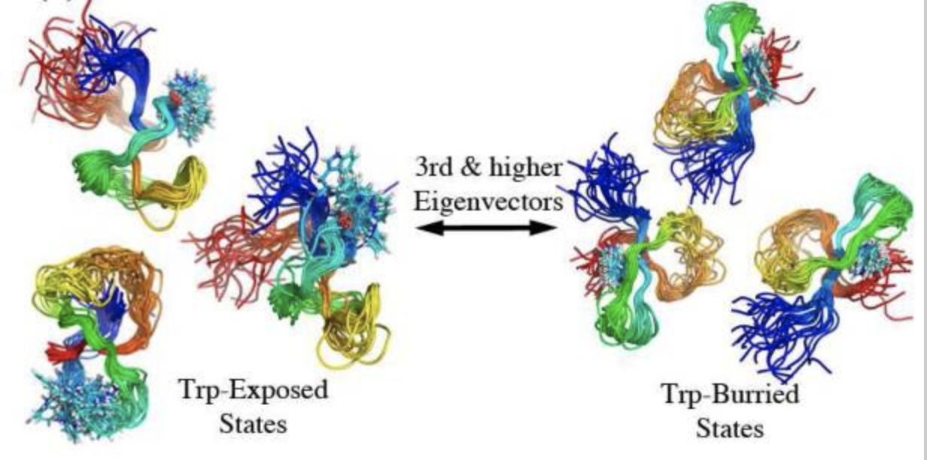
Cluster 3D Structures of Proteins

Slide 9
Clustering as Optimization
The clustering problem is an optimization problem
We define an "objective function"
Mathematically encodes what we consider to be ideal properties of clusters
Different clustering methods have different objective functions
These objective functions result in different ways of clustering the data

Slide 10
Points

Slide 11
Within-Cluster Variance
2 Clusters
4 Clusters

Slide 12
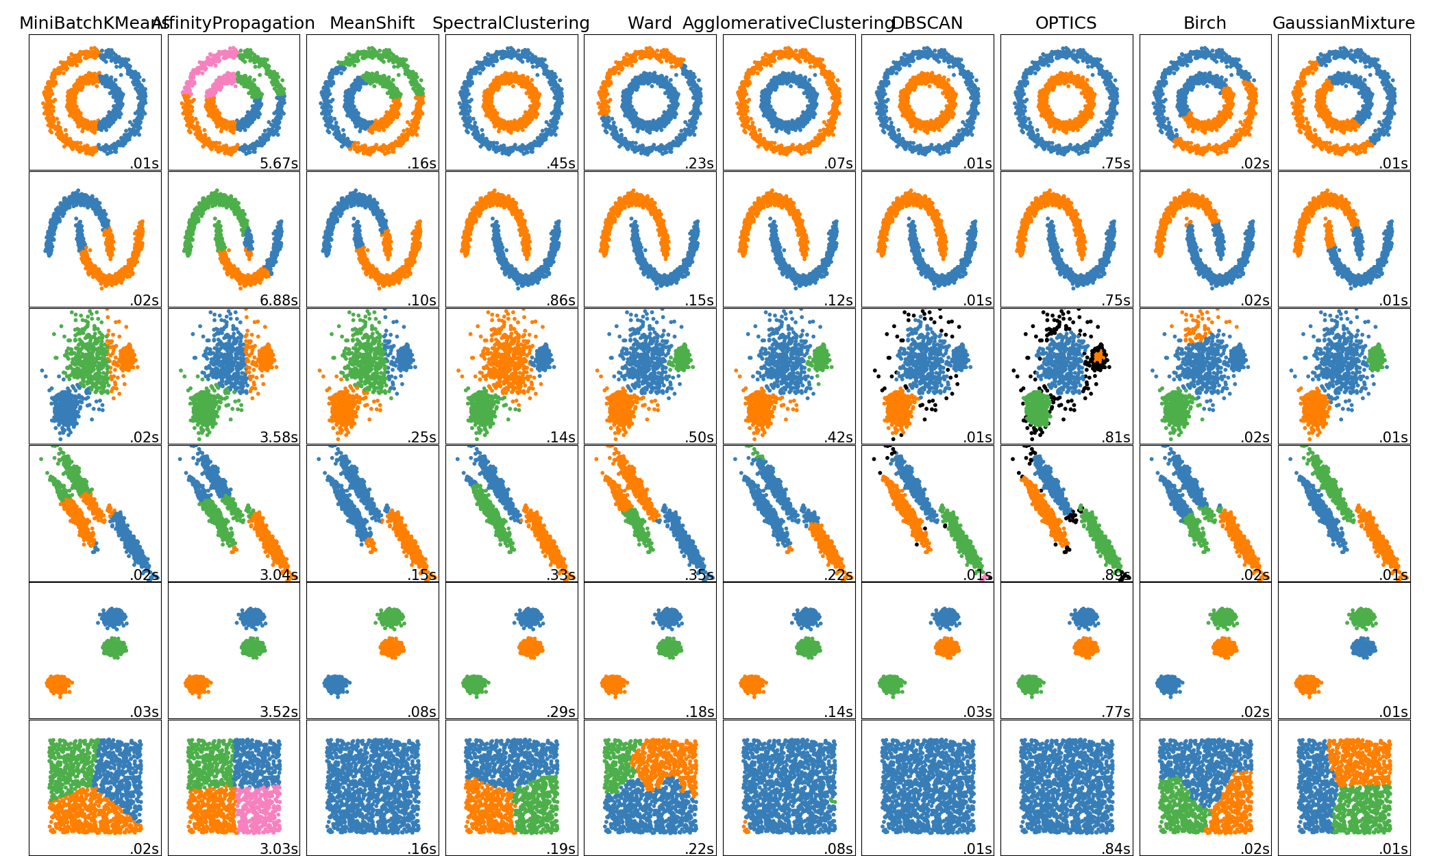
Clustering Algorithms

Slide 13
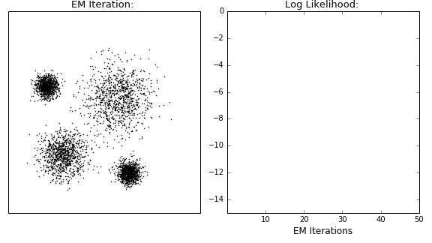
Gaussian Mixture Models
Estimates latent variables to describe clusters
Gaussian Mixture Models (estimates mean and covariance)
Maximizes log-likelihood of observed data
https://dashee87.github.io/data%20science/general/Clustering-with-Scikit-with-GIFs/

Slide 14
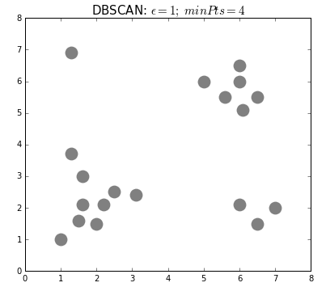
DBSCAN
Density-based spatial clustering of applications with noise
Number of clusters not required
Expands cluster by looking for points within “neighborhood” of cluster points
https://dashee87.github.io/data%20science/general/Clustering-with-Scikit-with-GIFs/

Slide 15
K-Means
Represents clusters using "center" points called centroids
Points are assigned to clusters based on distance to the centroids
One of the fastest clustering algorithms
Generates "evenly sized" clusters

Slide 16
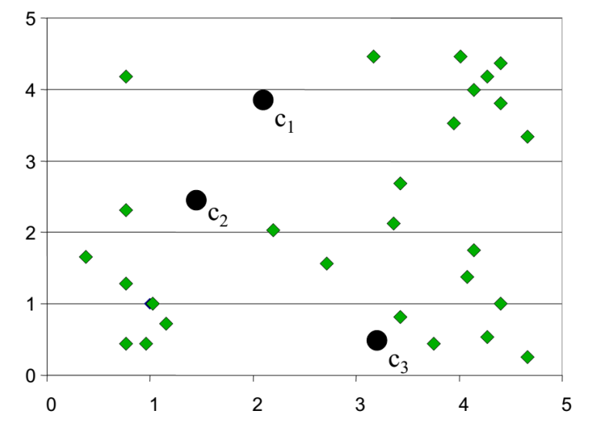
K-means clustering – step 1
Randomly initialize the center of the clusters
Shimon Ullman et al. 2014 – Center for Brains Minds & Machines

Slide 17
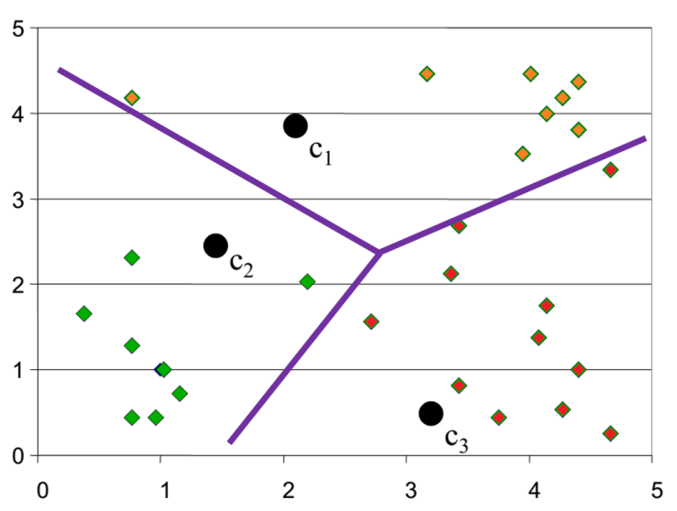
K-means clustering – step 2
Determine cluster membership for each datapoint
Shimon Ullman et al. 2014 – Center for Brains Minds & Machines

Slide 18
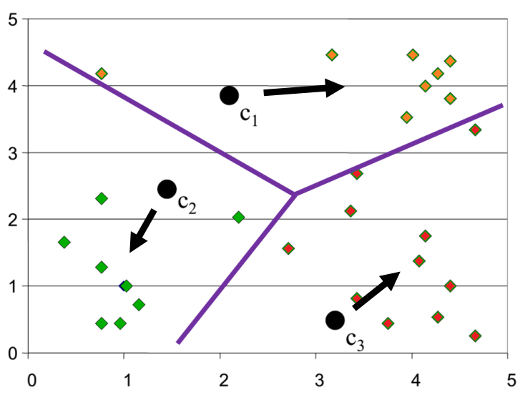
K-means clustering – step 3
Estimate the new position for the cluster centers
Shimon Ullman et al. 2014 – Center for Brains Minds & Machines

Slide 19
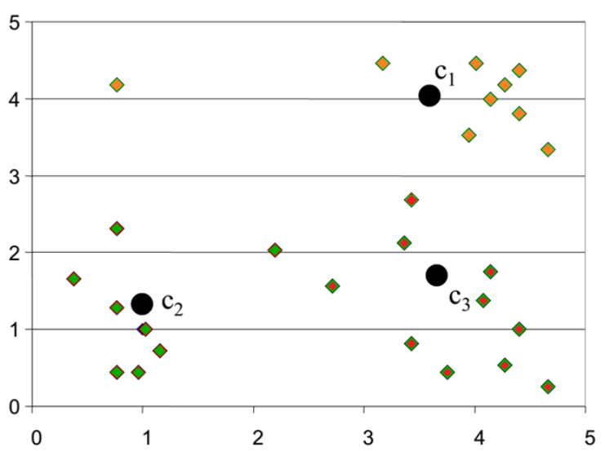
K-means clustering – step 3
Estimate the new position for the cluster centers
Shimon Ullman et al. 2014 – Center for Brains Minds & Machines

Slide 20
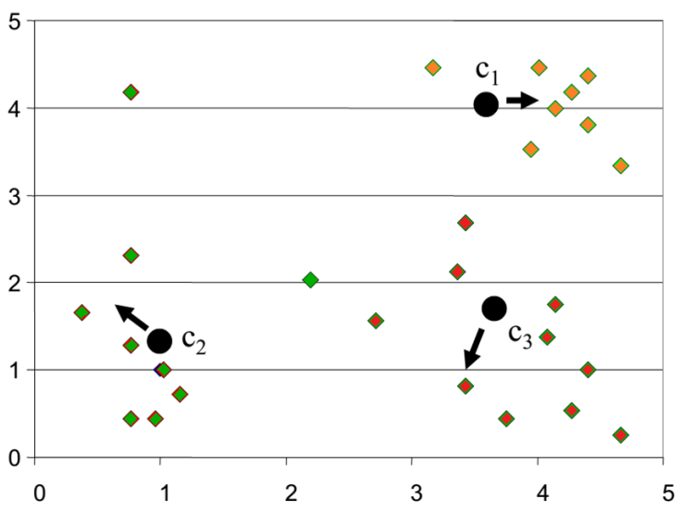
K-means clustering – Iteration 2
Shimon Ullman et al. 2014 – Center for Brains Minds & Machines

Slide 21
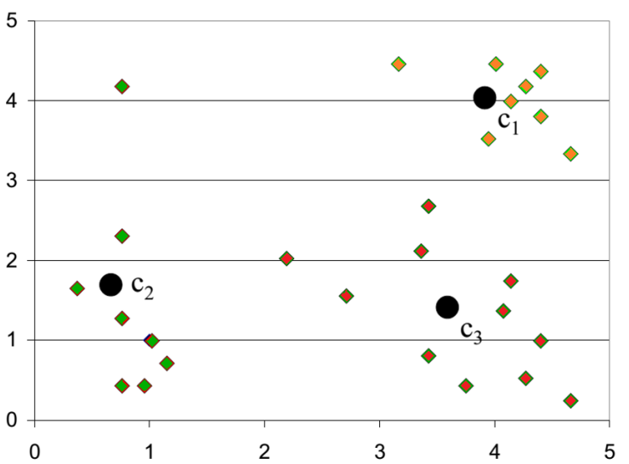
K-means clustering – Iteration 2
Shimon Ullman et al. 2014 – Center for Brains Minds & Machines

Slide 22
Centroid-Based Optimization Problem
Choose K cluster (x₁, ..., x_{k}) centers that minimize:
X – N x P feature matrix
K – number of clusters
x_{n} - row n of X
x^{k} – centroid for cluster k
r_{nk} – N x K matrix 1 if sample n is in cluster k, 0 otherwise
Notes:
r_{nk} = \begin{cases}
1 & \quad \text{if } k = \text{arg\,min}{}_j \|x_n - \bar{x}_k \|^2 \\
0 & \quad \text{otherwise}
\end{cases}
J = \sum_{n=1}^N \sum_{k=1}^K r_{nk} \| x_n - \bar{x}_k \|^2

Slide 23
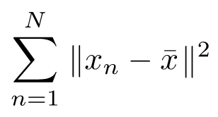
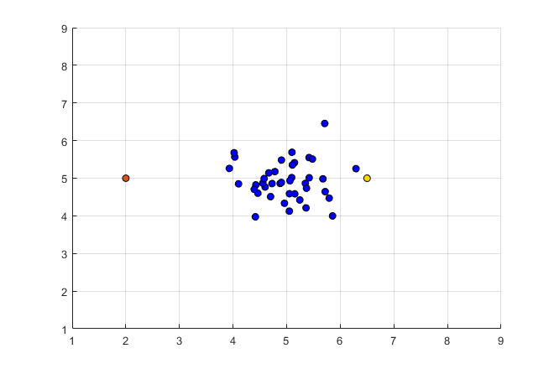
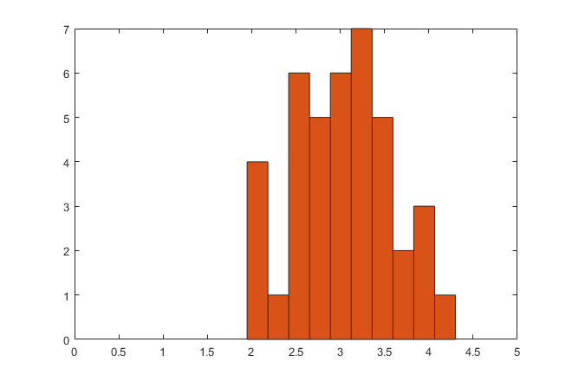
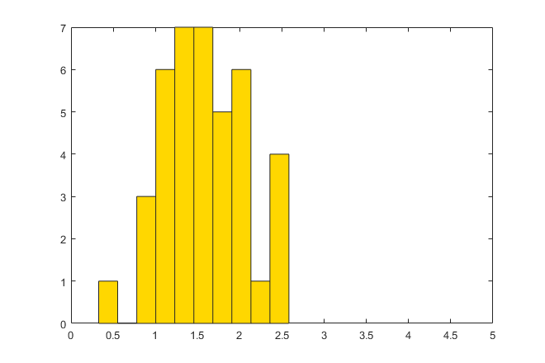
Intra-cluster variation
Sum of Square errors

Slide 24
Intra-cluster variation
= 379
= 114

Slide 25
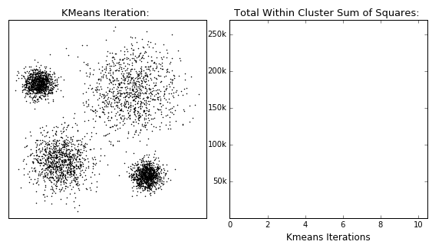
K-Means
https://dashee87.github.io/data%20science/general/Clustering-with-Scikit-with-GIFs/

Slide 26
Hierarchical Clustering (Ward's)

Slide 27
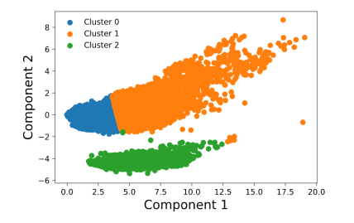
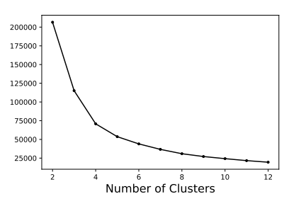
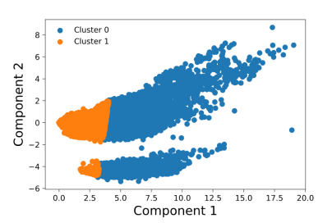
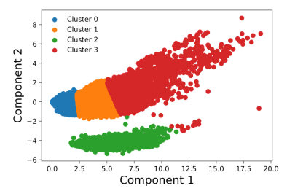
Inertia – Example 1

Slide 28
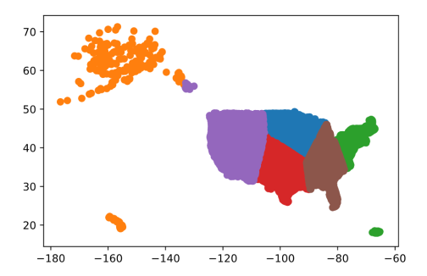
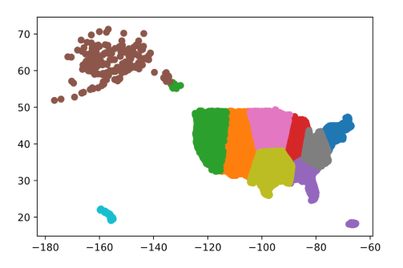
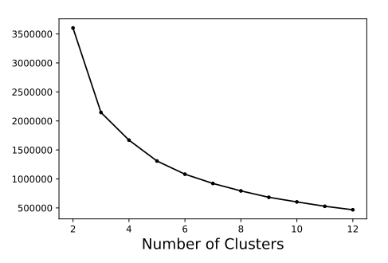
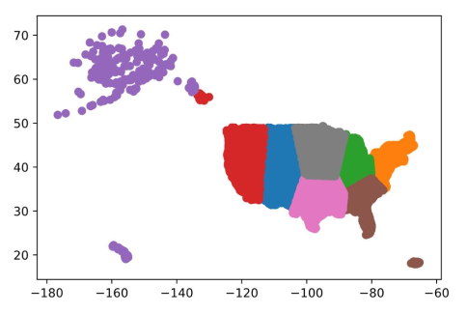
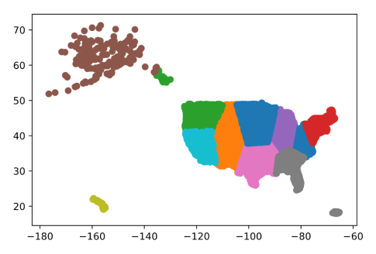
Inertia – Example 2
K = 6
K = 10
K = 8
K = 11

Slide 29
Hierarchical Clustering (Ward's)
50 Clusters
25 Clusters

Slide 30
Hierarchical Clustering (Ward's)
10 Clusters
4 Clusters

Slide 31
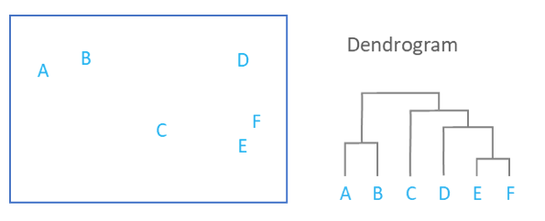
Dendrogram

Slide 32
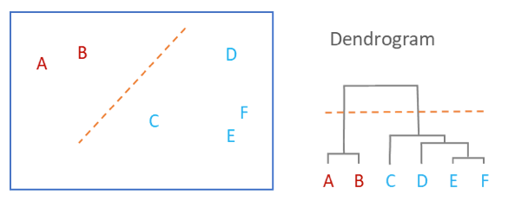
Dendrogram

Slide 33

Dendrogram example
https://dashee87.github.io/data%20science/general/Clustering-with-Scikit-with-GIFs/

Slide 34
Hierarchical Linkage Criterion
Single Linkage
Known as nearest neighbor clustering.
Distance between two groups is defined as the distance between their two nearest members
Tends to yield clusters where individuals are added sequentially to a single group.
Complete
Known as further neighbor or maximum method
Distance between two groups is defined as the distance between the two farthest-apart members.
Tends to yield clusters that are well separated and compact.

Slide 35
Hierarchical Linkage Criterion
Average
Known as the unweighted pair-group method
Distance between two groups is defined as the average distance between each of their members.
Ward
Smallest distance between all pairs of points in two clusters
Groups are formed so as to minimize the within-group sum of squares.

Slide 36
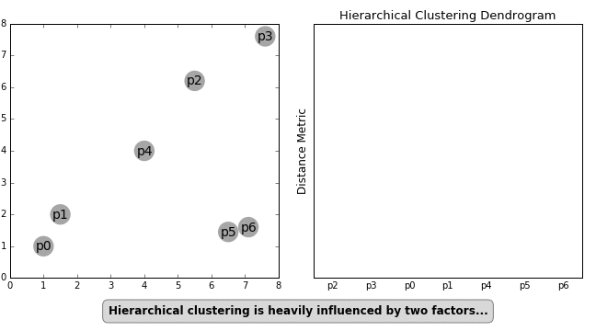
Linkage Criterion -> Cluster Shapes
https://dashee87.github.io/data%20science/general/Clustering-with-Scikit-with-GIFs/

Slide 37
Clustering Algorithms

